Slide 1
Travels
путешествия

Slide 2
There are many types of travels .
есть много видов путешествий .

Slide 3
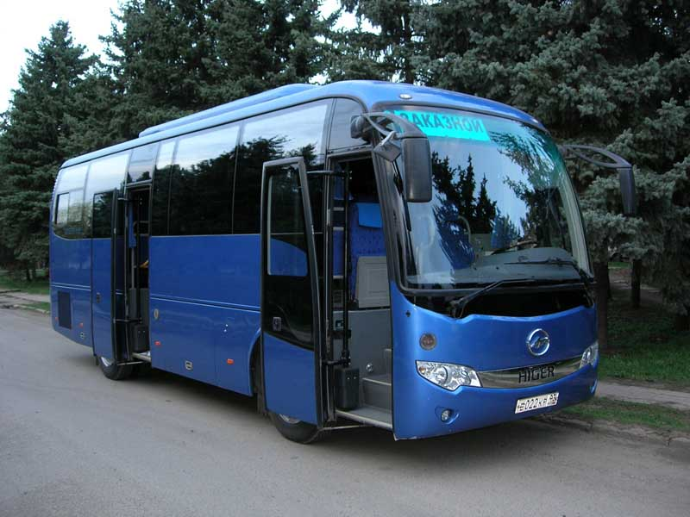
By coach

Slide 4
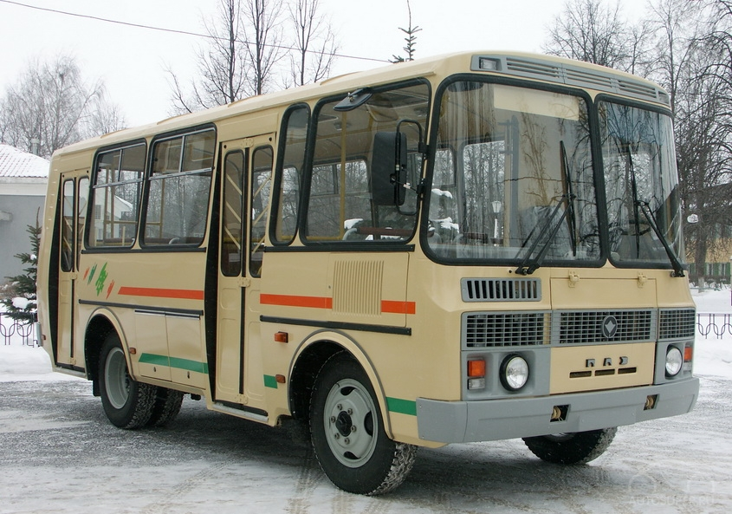
By bus

Slide 5
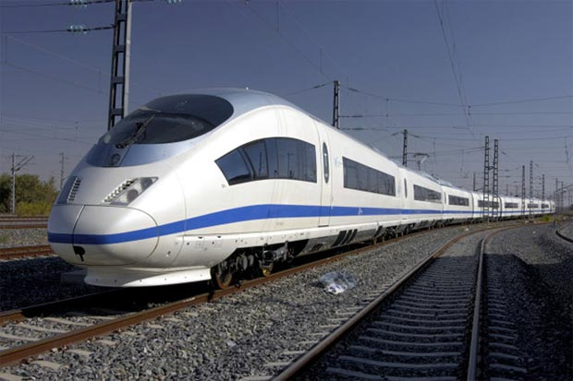
By train

Slide 6

By plain

Slide 7
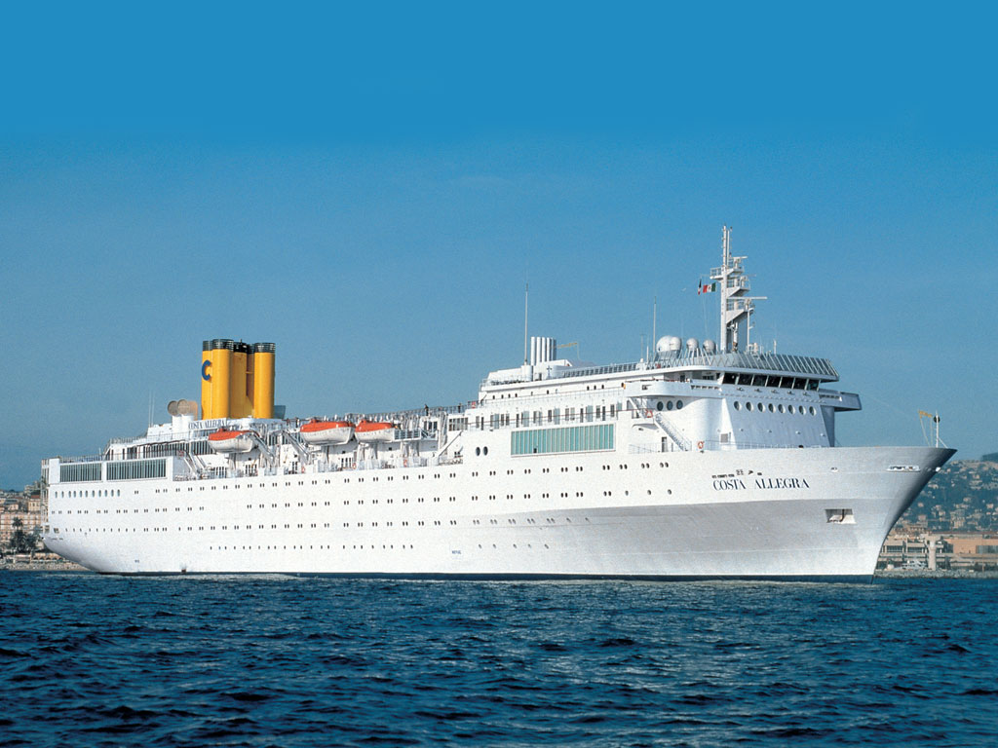
By ship

Slide 8
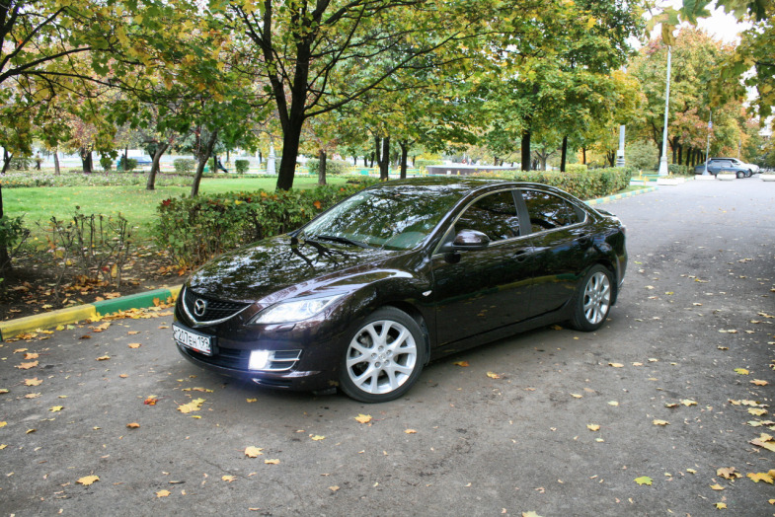
By car

Slide 9
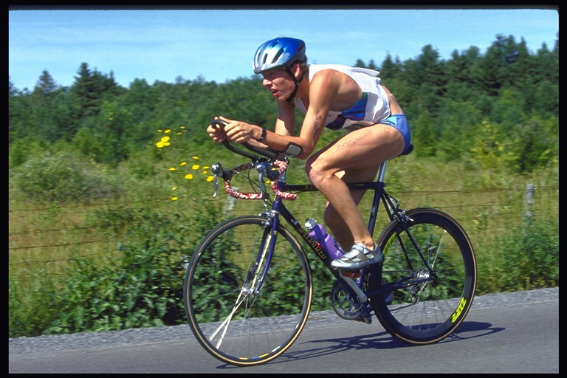
By bike

Slide 10
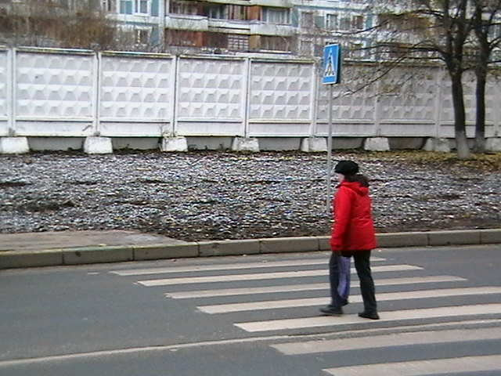
On foot

Slide 11
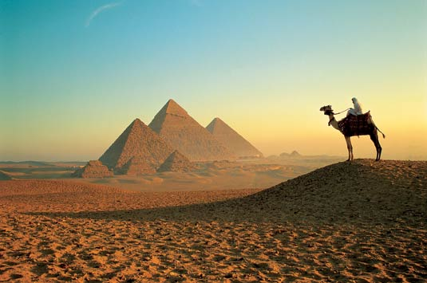
Abroad

Slide 12

Hotel

Slide 13
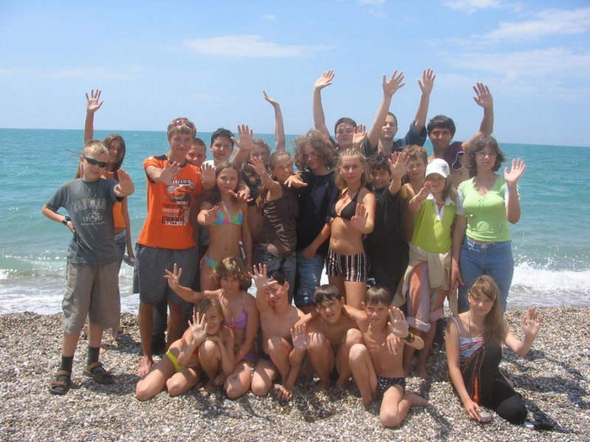
Camp

Slide 14
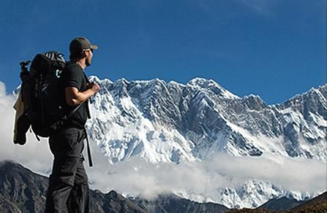
Hiking

Slide 15
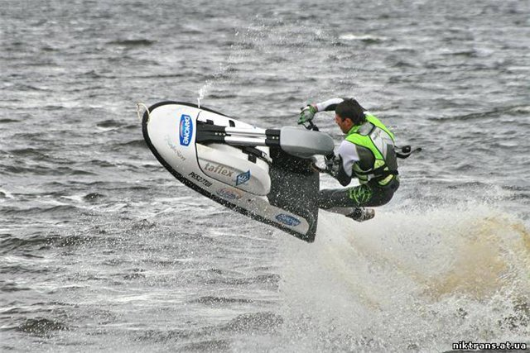
Jet skiing

Slide 16

Sailing

Slide 17

Windsurfing

Slide 18
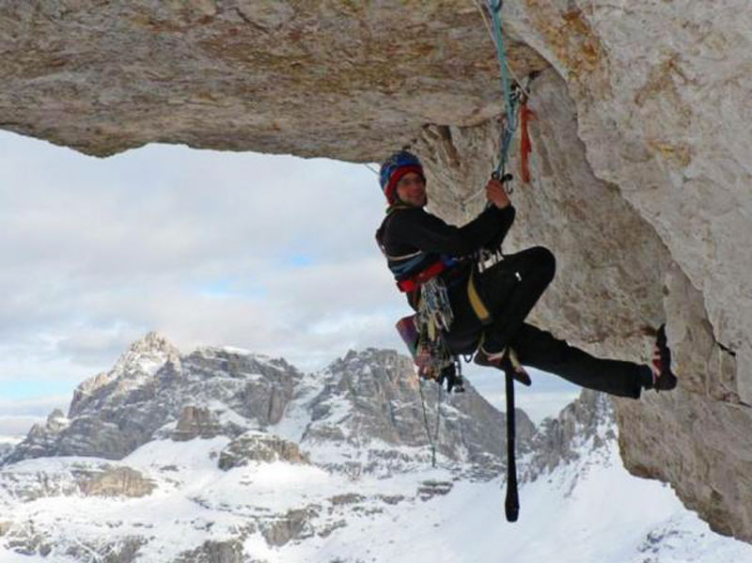
Mountaineering

Slide 19
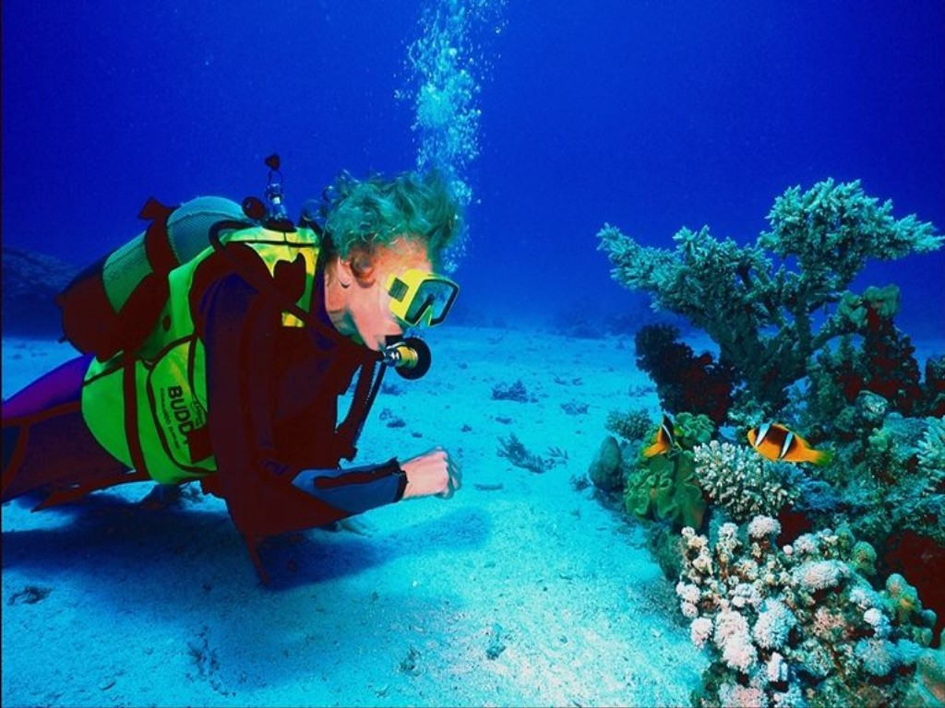
Scuba diving

Slide 20
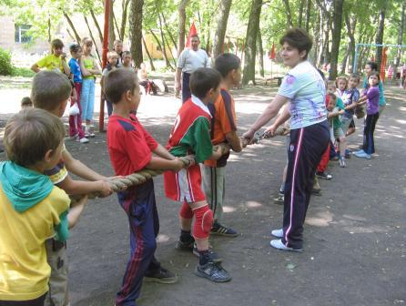
Activity holiday

Slide 21
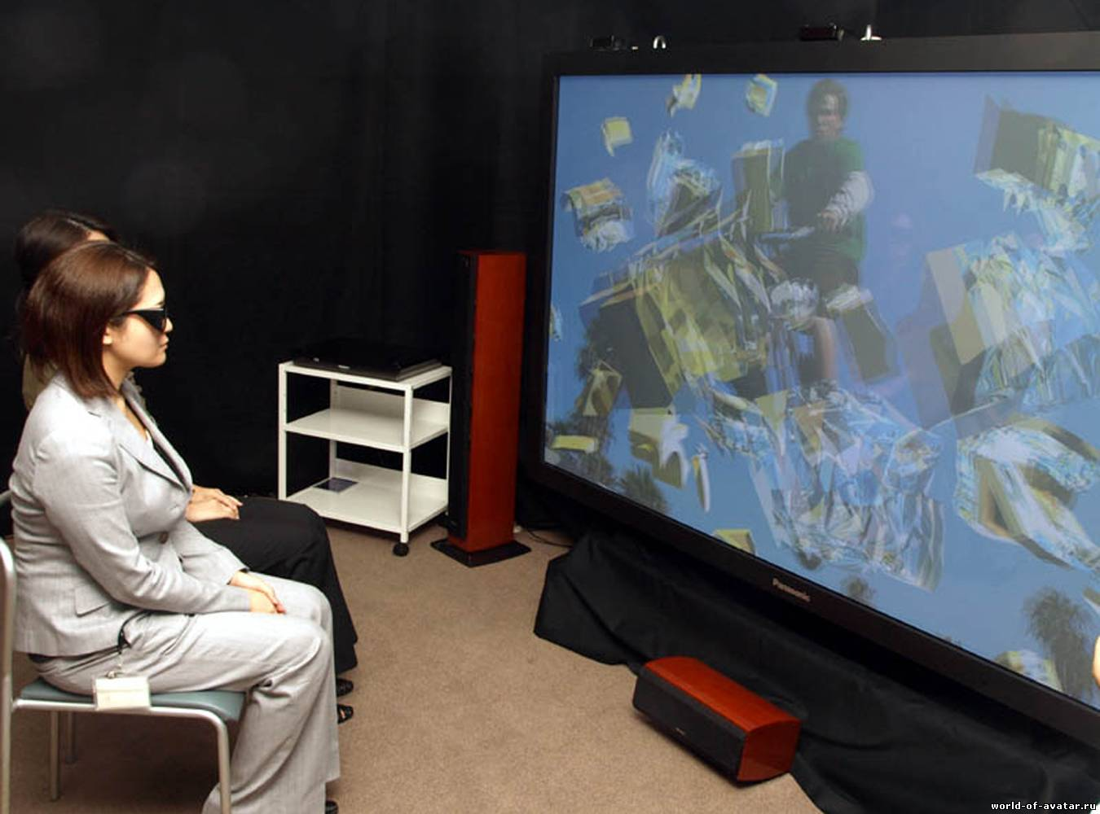
Leisure

